Slide 1


Operating System Concepts (MCA-204) Unit 2
Department of Information Technology & Computer Application, Madan Mohan Malaviya University of Technology
Gorakhpur-273010,India

Slide 2
Content
Processor management: CPU scheduling – short-term, medium term and long term scheduling, non-preemptive and preemptive algorithms, performance analysis of multiprogramming, multiprocessing and interactive systems, Concurrent processes, precedence graphs, critical section problem, semaphores; Classical process, co-ordination problems, Producer-consumer problem, Reader-writer problem, Dining philosophers problem, Barber’s shop problem, Interprocess communication.

Slide 3
Processor Management
In multiprogramming environment, the OS decides which process gets the processor when and for how much time. This function is called process scheduling. An Operating System does the following activities for processor management −
Keeps tracks of processor and status of process. The program responsible for this task is known as traffic controller.
Allocates the processor (CPU) to a process.
De-allocates processor when a process is no longer required.

Slide 4
CPU scheduling
CPU Scheduling is a process of determining which process will own CPU for execution while another process is on hold. The main task of CPU scheduling is to make sure that whenever the CPU remains idle, the OS at least select one of the processes available in the ready queue for execution. The selection process will be carried out by the CPU scheduler. It selects one of the processes in memory that are ready for execution.
CPU Scheduling
Pre-Emptive
Non-Preemptive

Slide 5
Preemptive Scheduling
In Preemptive Scheduling, the tasks are mostly assigned with their priorities. Sometimes it is important to run a task with a higher priority before another lower priority task, even if the lower priority task is still running. The lower priority task holds for some time and resumes when the higher priority task finishes its execution.
Non-Preemptive Scheduling
In this type of scheduling method, the CPU has been allocated to a specific process. The process that keeps the CPU busy will release the CPU either by switching context or terminating. It is the only method that can be used for various hardware platforms. That's because it doesn't need special hardware (for example, a timer) like preemptive scheduling.

Slide 6
CPU scheduling Terminologies
Arrival Time: Time at which the process arrives in the ready queue.
Completion Time: Time at which process completes its execution.
Burst Time: Time required by a process for CPU execution.
Turn Around Time: Time Difference between completion time and arrival time. Turn Around Time = Completion Time – Arrival Time
Waiting Time(W.T): Time Difference between turn around time and burst time. Waiting Time = Turn Around Time – Burst Time

Slide 7
Types of CPU scheduling Algorithm or Non-Preemptive and Preemptive Algorithms
There are mainly six types of process scheduling algorithms
First Come First Serve (FCFS)
Shortest-Job-First (SJF) Scheduling
Shortest Remaining Time
Priority Scheduling
Round Robin Scheduling
Multilevel Queue Scheduling

Slide 8
First Come First Serve (FCFS)
Jobs are executed on first come, first serve basis.
It is a non-preemptive scheduling algorithm.
Easy to understand and implement.
Its implementation is based on FIFO queue.

Slide 9
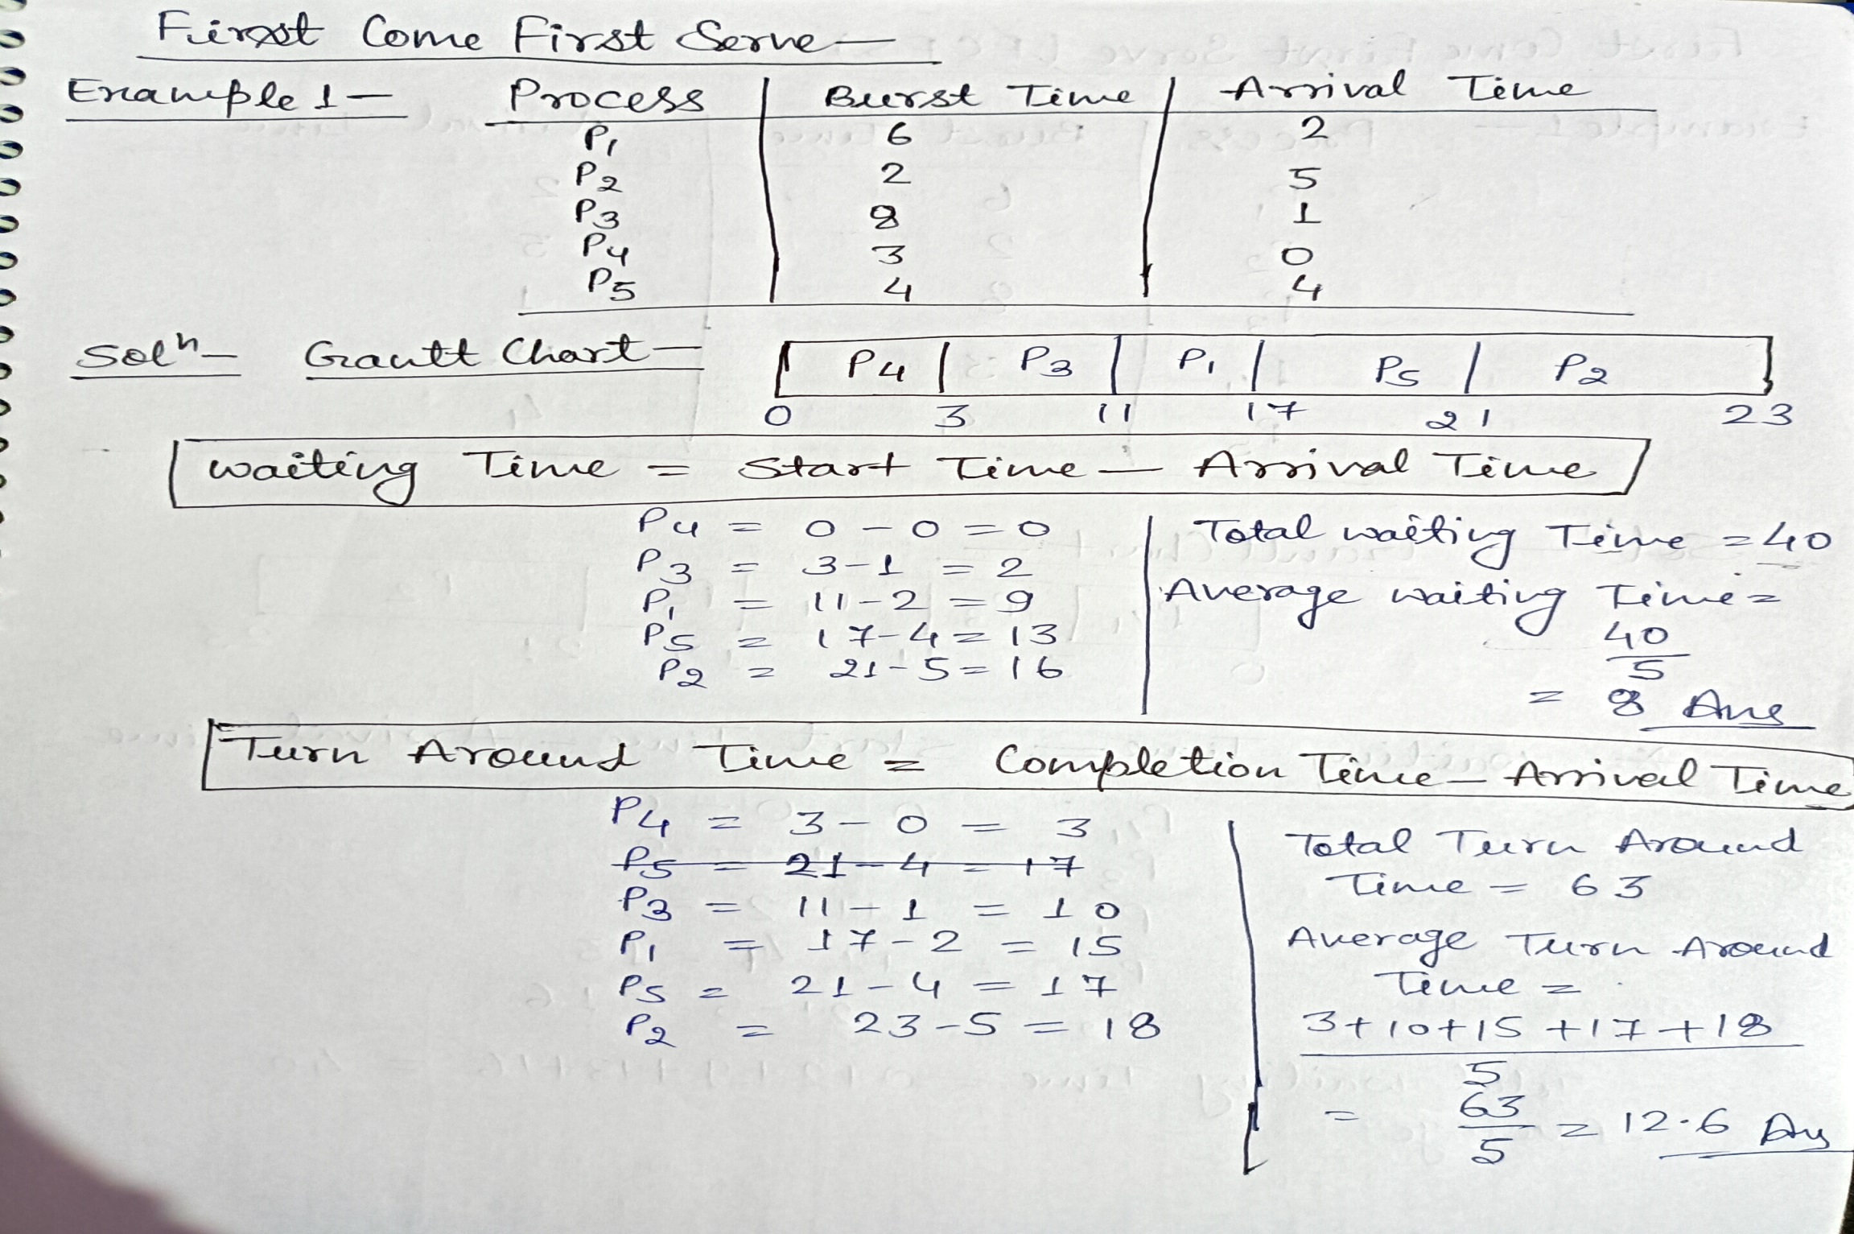

Slide 10
Example 2:
Example 3:
Process | Arrival Time | Burst Time
P1 | 0 | 4
P2 | 1 | 3
P3 | 2 | 1
P4 | 3 | 2
P5 | 4 | 5
Process | Arrival Time | Burst Time
P1 | 0 | 18
P2 | 2 | 7
P3 | 2 | 10

Slide 11
Shortest Job First (SJF)
This is also known as shortest job next, or SJN.
This is a non-preemptive, pre-emptive scheduling algorithm.
Best approach to minimize waiting time.
Easy to implement in Batch systems where required CPU time is known in advance.
Impossible to implement in interactive systems where required CPU time is not known.
The processer should know in advance how much time process will take.

Slide 12
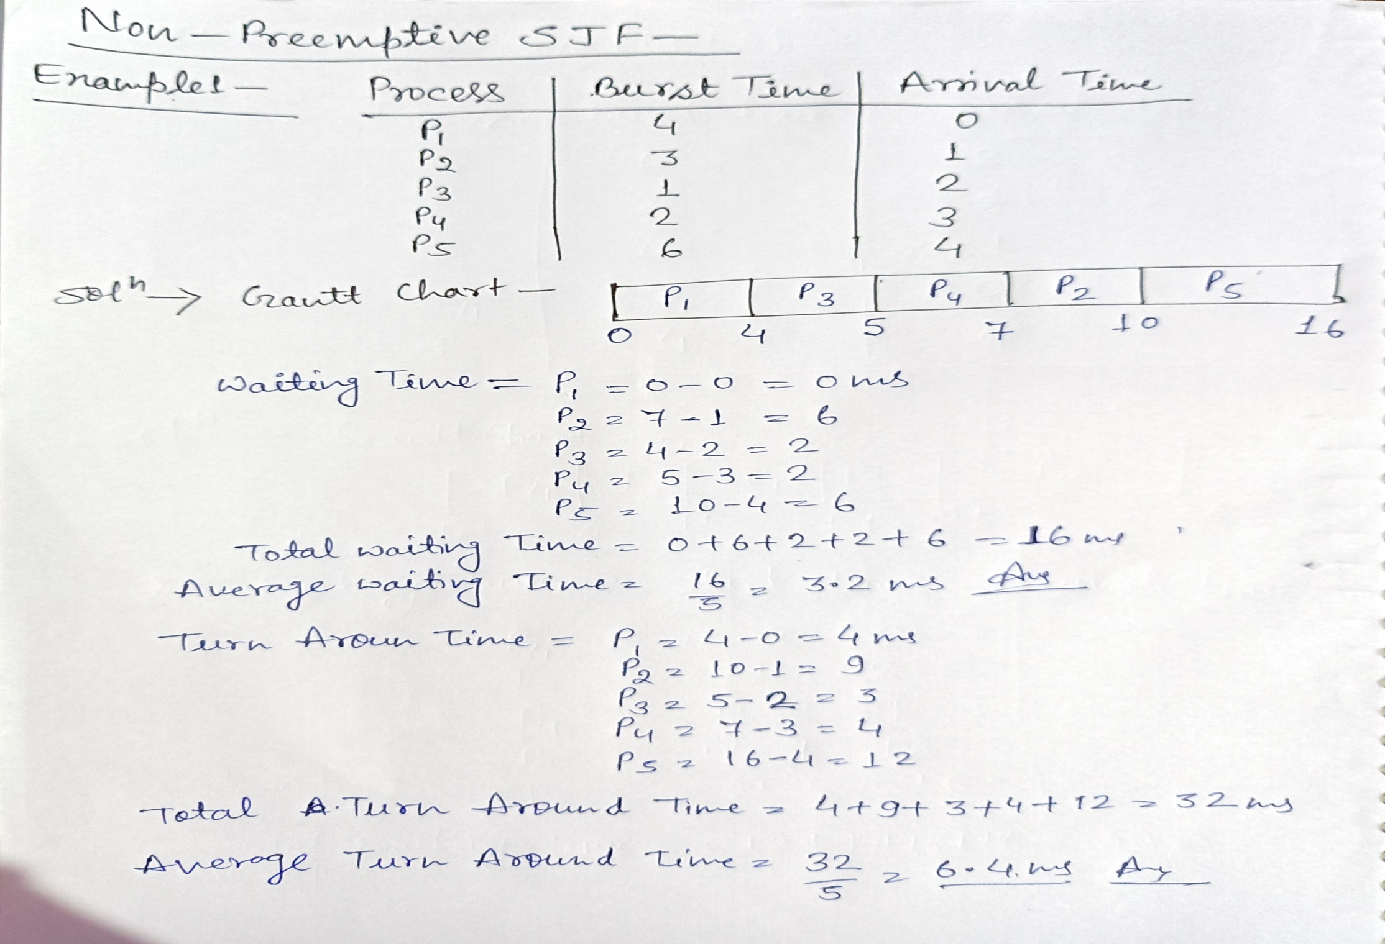

Slide 13
Example 2:
Example 3:
Process | Arrival Time | Burst Time
P0 | 0 | 10
P1 | 1 | 6
P2 | 3 | 2
P3 | 5 | 4
Process | Burst Time | Arrival Time
P1 | 6 | 9
P2 | 8 | 1
P3 | 7 | 4
P4 | 3 | 0
P5 | 9 | 2

Slide 14
Shortest Remaining Time
Shortest remaining time (SRT) is the preemptive version of the SJF algorithm.
The processor is allocated to the job closest to completion but it can be preempted by a newer ready job with shorter time to completion.
Impossible to implement in interactive systems where required CPU time is not known.
It is often used in batch environments where short jobs need to give preference.

Slide 15
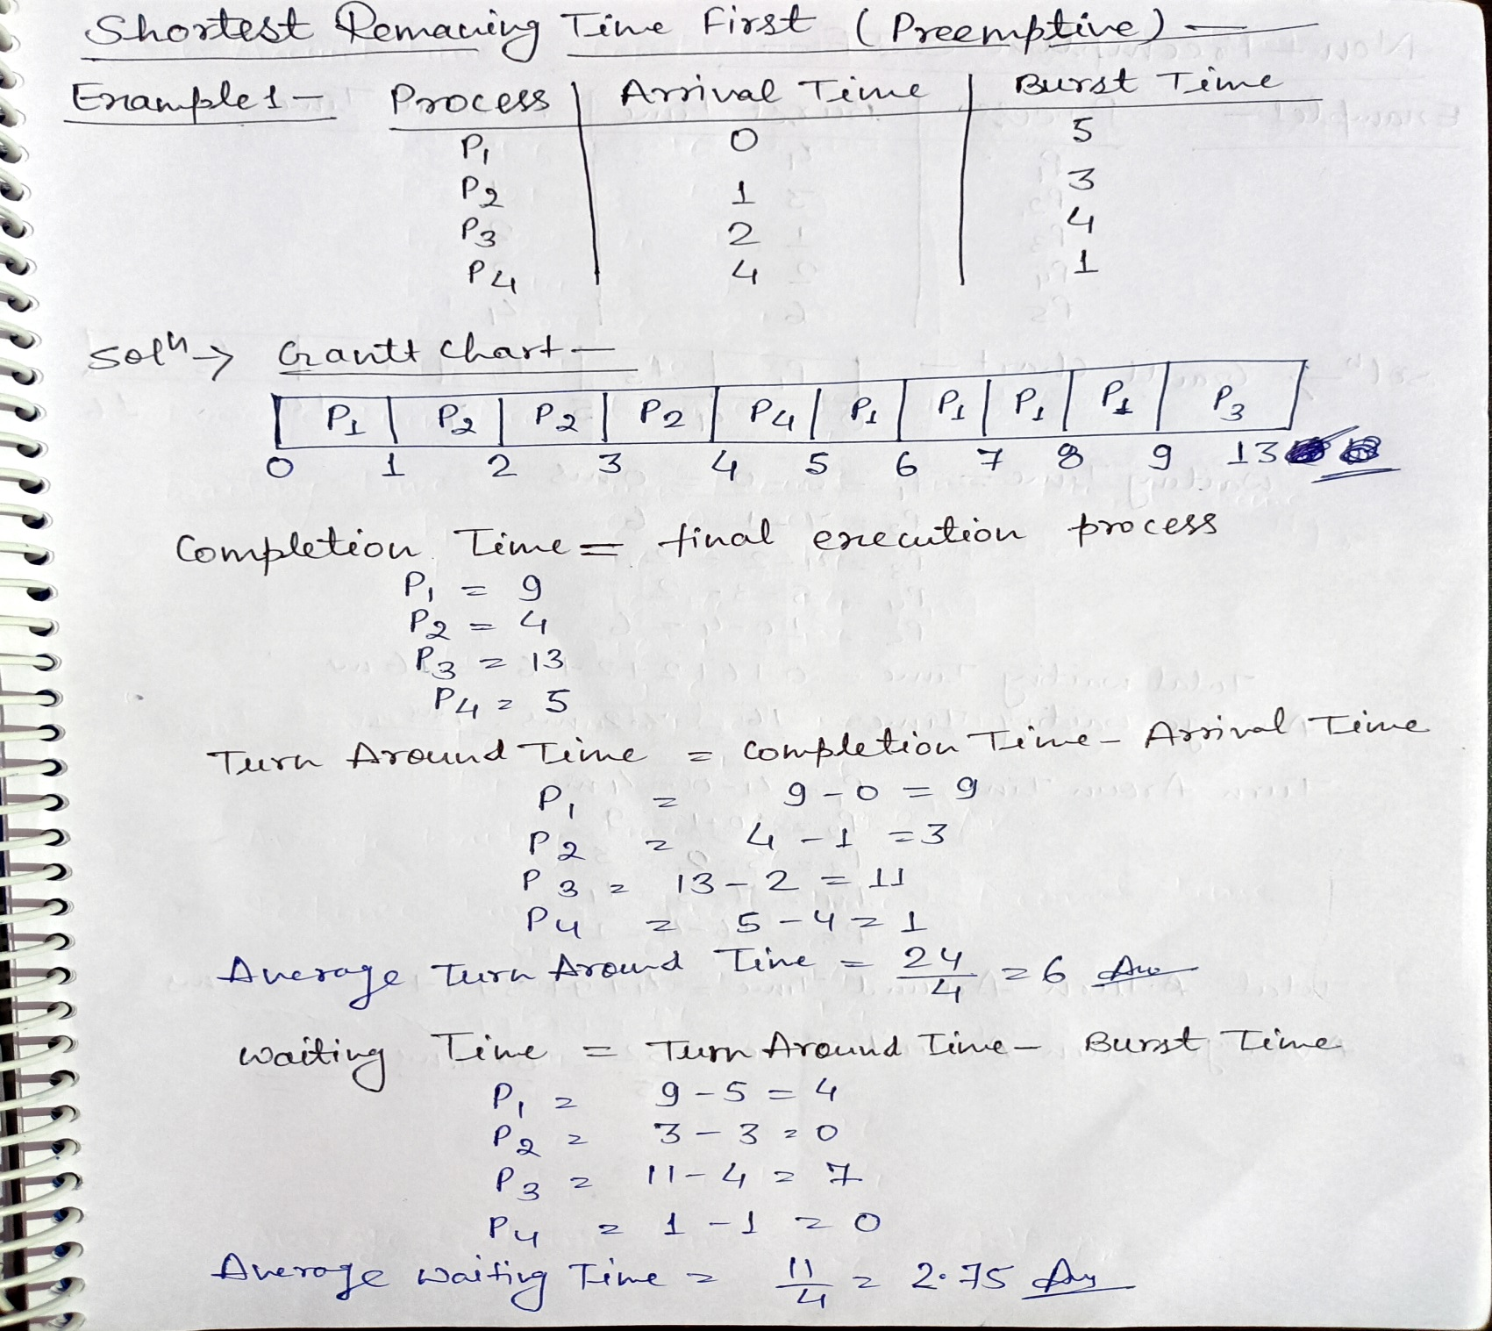
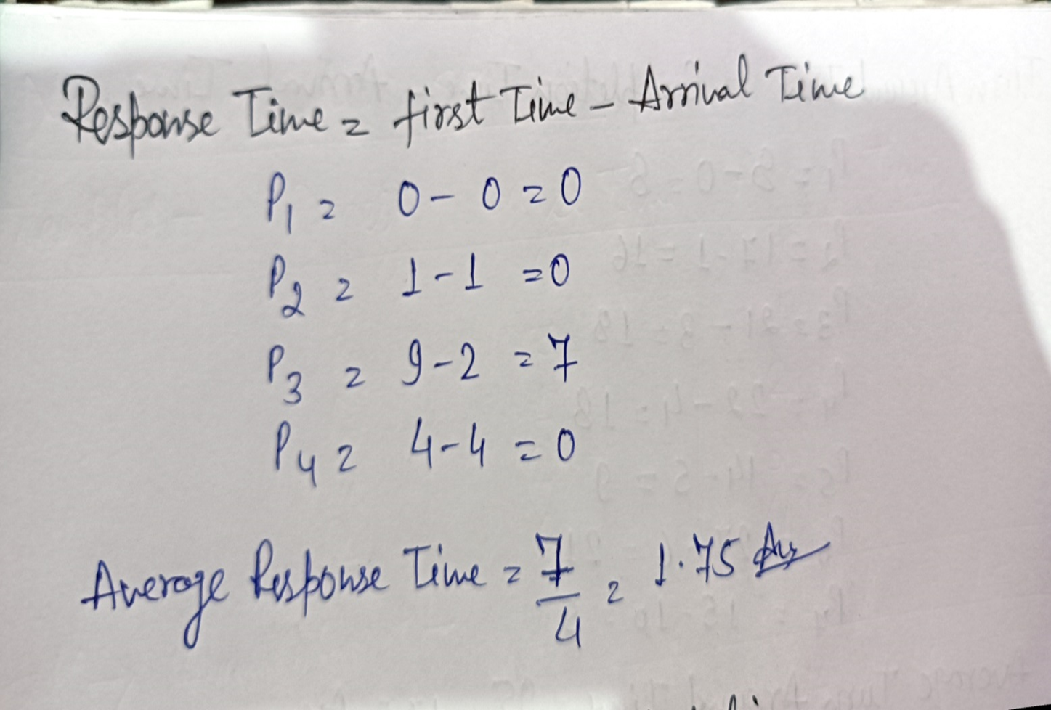

Slide 16
Example 2:
Example 3:
Process | Arrival Time | Burst Time
P1 | 0 | 7
P2 | 1 | 5
P3 | 2 | 3
P4 | 3 | 1
P5 | 4 | 2
P6 | 5 | 1
Process | Arrival Time | Burst Time
P1 | 2 | 1
P2 | 1 | 5
P3 | 4 | 1
P4 | 0 | 6
P5 | 2 | 3

Slide 17
Priority Scheduling
Priority scheduling is a non-preemptive and preemptive algorithm and one of the most common scheduling algorithms in batch systems.
Each process is assigned a priority. Process with highest priority is to be executed first and so on.
Processes with same priority are executed on first come first served basis.
Priority can be decided based on memory requirements, time requirements or any other resource requirement.

Slide 18
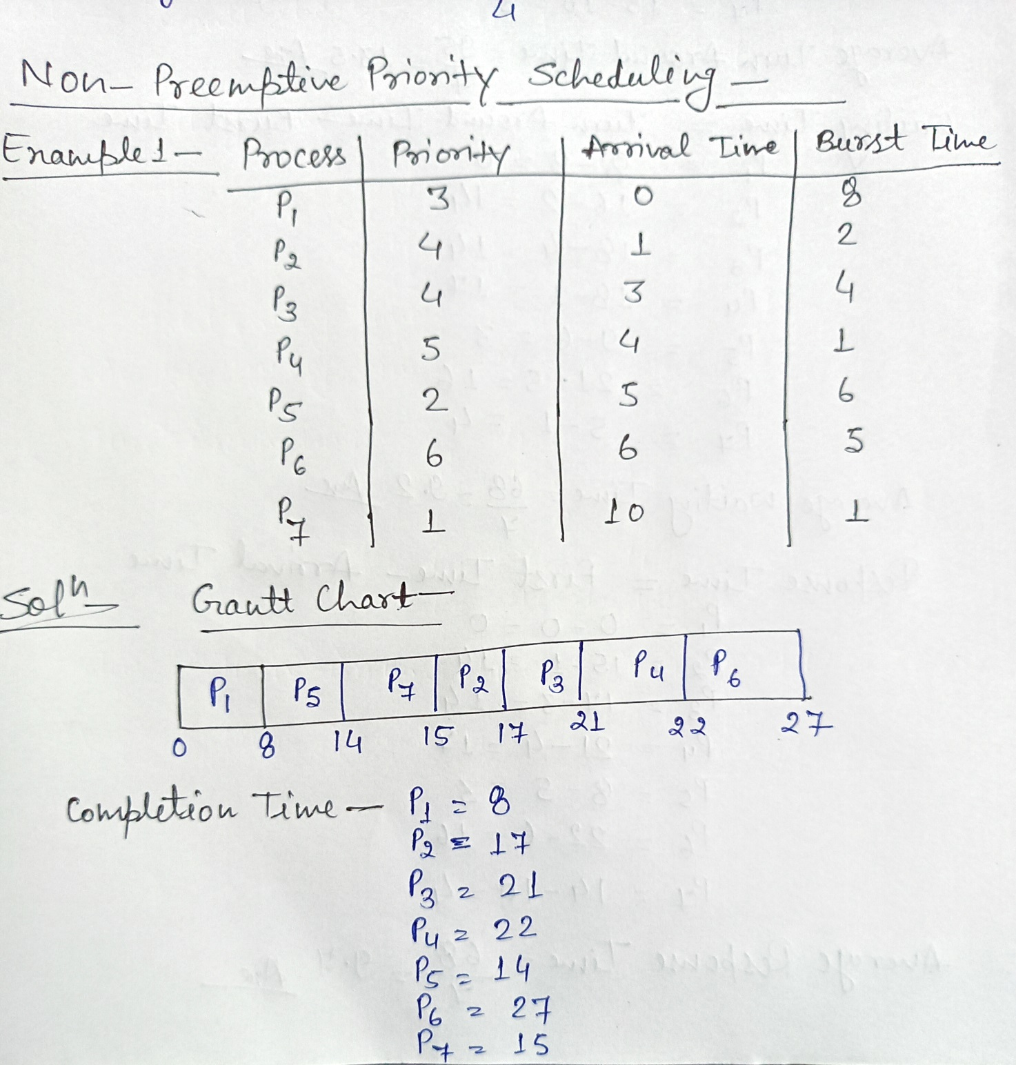
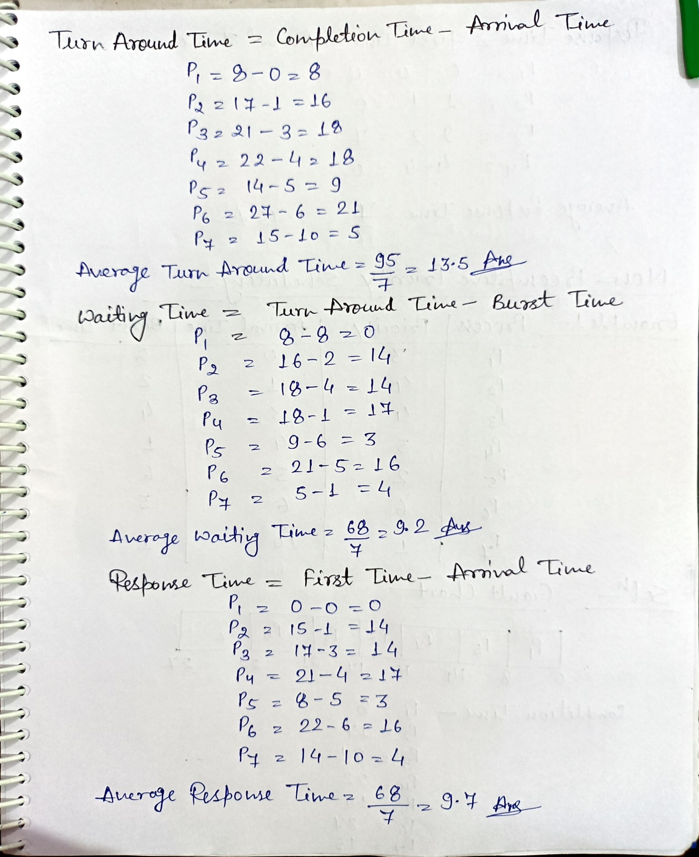

Slide 19
Example 2:
Example 3:
Process | Arrival Time | Burst Time | Priority
P1 | 0 | 11 | 2
P2 | 5 | 28 | 0
P3 | 12 | 2 | 3
P4 | 2 | 10 | 1
P5 | 9 | 16 | 4
Process | Arrival / Burst Time | Priority
P1 | 10 | 3
P2 | 1 | 1
P3 | 2 | 4
P4 | 1 | 5
P5 | 5 | 2

Slide 20
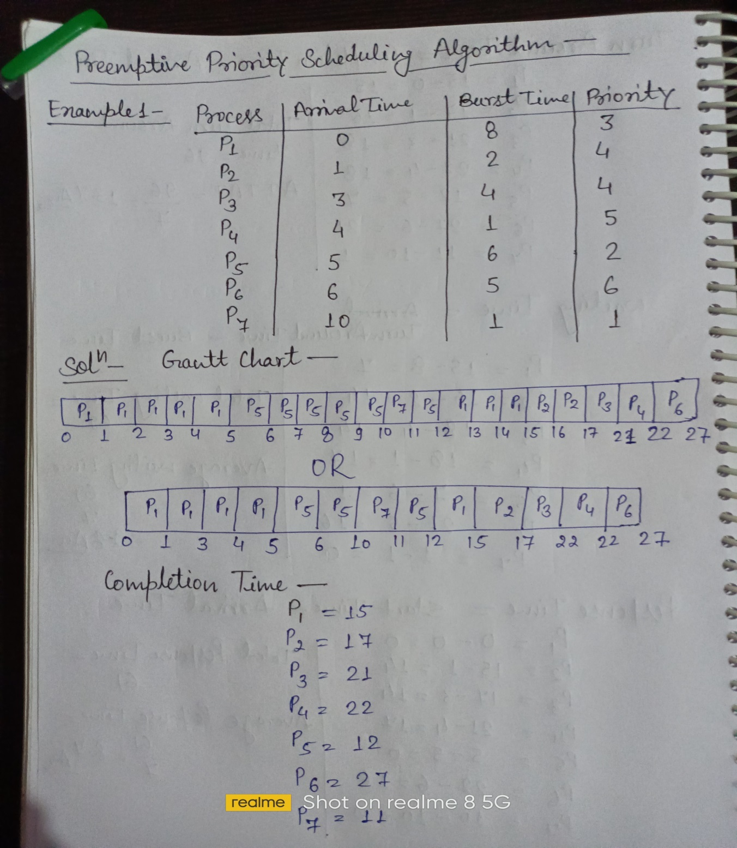
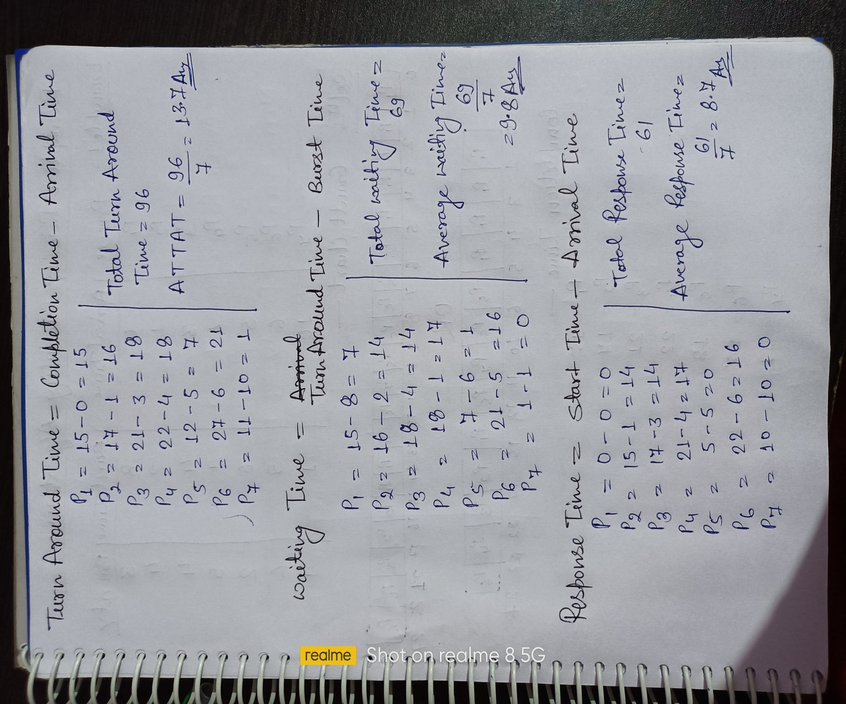

Slide 21
Example 2: Use higher the number higher the priority for this question.
Example 3:
Process | Arrival Time | Burst Time | Priority
P1 | 0 | 5 | 10
P2 | 1 | 4 | 20
P3 | 2 | 2 | 30
P4 | 4 | 1 | 40
Process | Arrival Time | Burst Time | Priority
P0 | 0 | 10 | 5
P1 | 1 | 6 | 4
P2 | 3 | 2 | 2
P3 | 5 | 4 | 0

Slide 22
Round Robin Scheduling
Round Robin is the preemptive process scheduling algorithm.
Each process is provided a fix time to execute, it is called a quantum.
Once a process is executed for a given time period, it is preempted and other process executes for a given time period.
Context switching is used to save states of preempted processes.

Slide 23
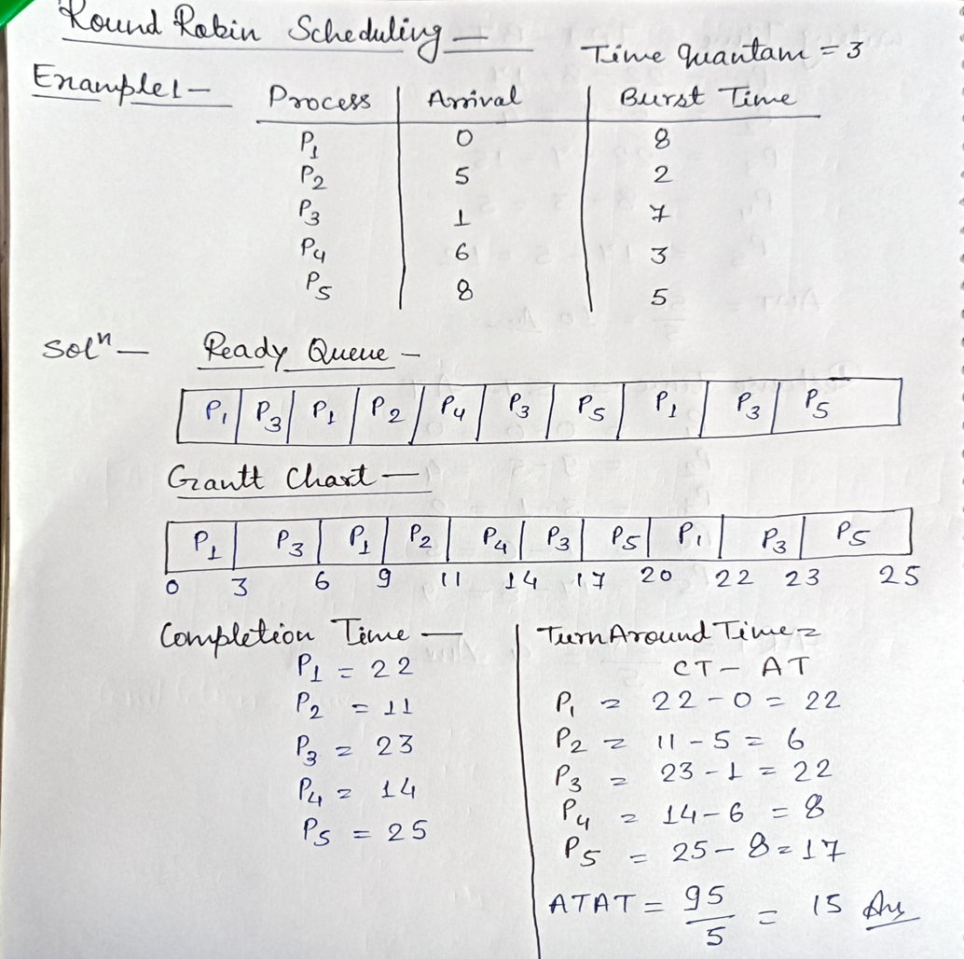
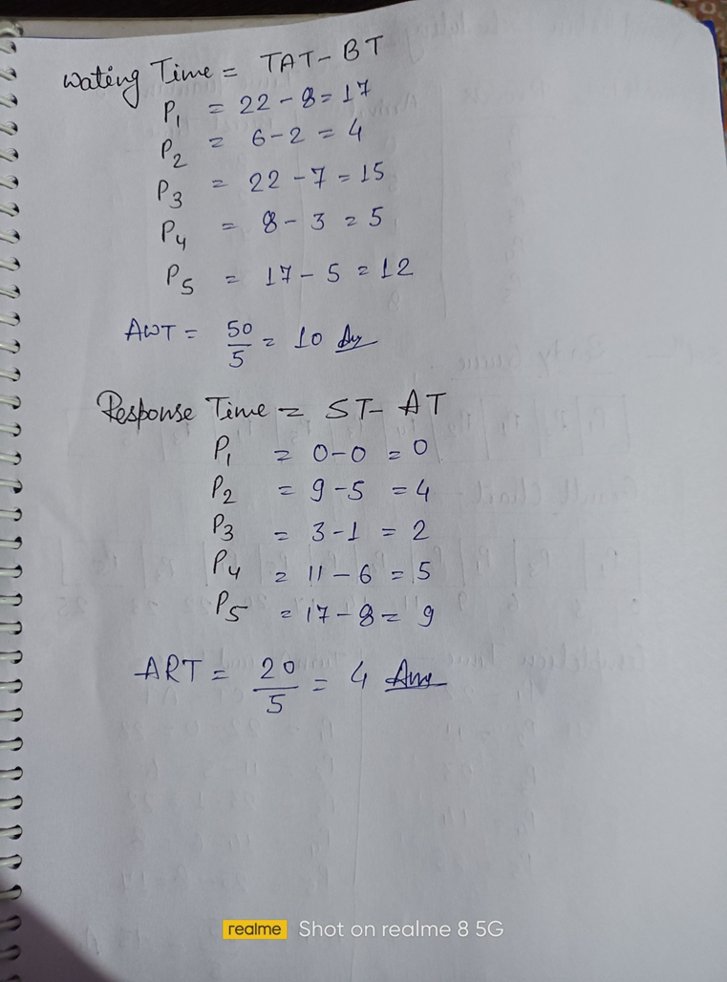

Slide 24
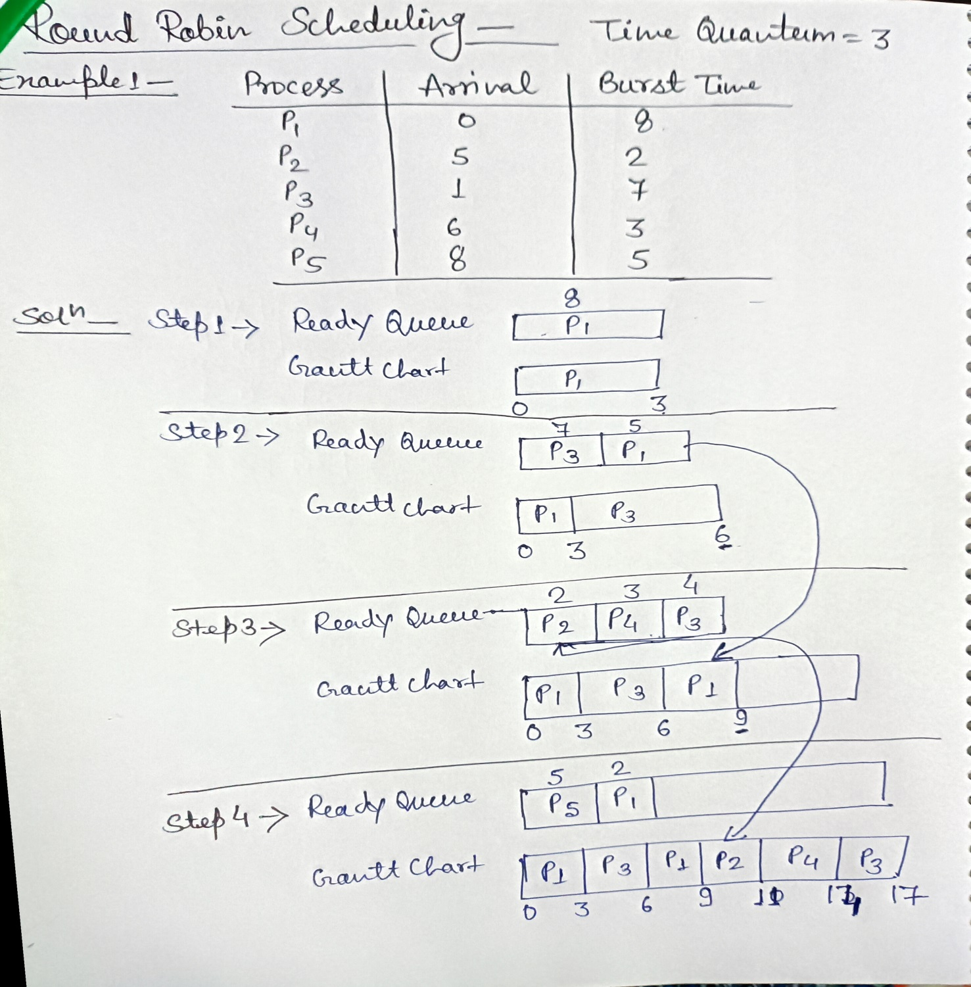
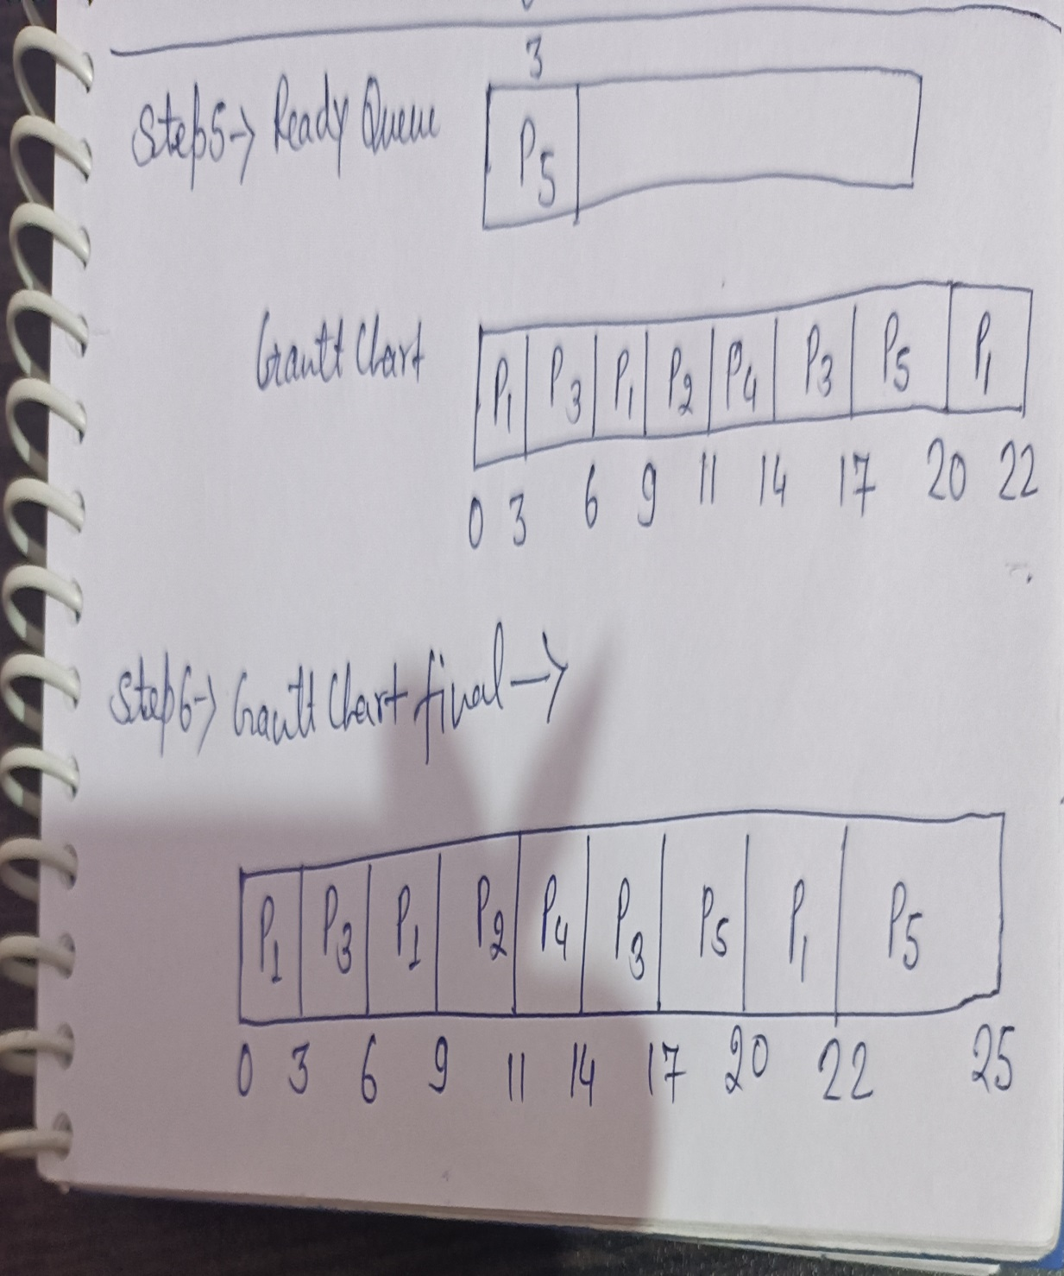

Slide 25
Example 2: Use time quantum 2
Example 3: Use time slice 2
Process | Arrival Time | Burst Time
P1 | 0 | 5
P2 | 1 | 4
P3 | 2 | 2
P4 | 4 | 1
Process | Arrival Time | Burst Time
P0 | 0 | 10
P1 | 1 | 6
P2 | 3 | 2
P3 | 5 | 4

Slide 26
Multilevel Queue Scheduling
Multiple-level queues are not an independent scheduling algorithm. They make use of other existing algorithms to group and schedule jobs with common characteristics.
Multiple queues are maintained for processes with common characteristics.
Each queue can have its own scheduling algorithms.
Priorities are assigned to each queue.
For example, CPU-bound jobs can be scheduled in one queue and all I/O-bound jobs in another queue. The Process Scheduler then alternately selects jobs from each queue and assigns them to the CPU based on the algorithm assigned to the queue.

Slide 28
Long-Term Scheduling
Long-term scheduling involves selecting the processes from the storage pool in the secondary memory and loading them into the ready queue in the main memory for execution. This is handled by the long-term scheduler or job scheduler.
The long-term scheduler controls the degree of multiprogramming. It must select a careful mixture of I/O bound and CPU bound processes to yield optimum system throughput. If it selects too many CPU bound processes then the I/O devices are idle and if it selects too many I/O bound processes then the processor has nothing to do.

Slide 29
Short-Term Scheduling
Short-term scheduling involves selecting one of the processes from the ready queue and scheduling them for execution. This is done by the short-term scheduler. A scheduling algorithm is used to decide which process will be scheduled for execution next by the short-term scheduler.
The short-term scheduler executes much more frequently than the long-term scheduler as a process may execute only for a few milliseconds.
The choices of the short term scheduler are very important. If it selects a process with a long burst time, then all the processes after that will have to wait for a long time in the ready queue. This is known as starvation and it may happen if a wrong decision is made by the short-term scheduler.

Slide 30
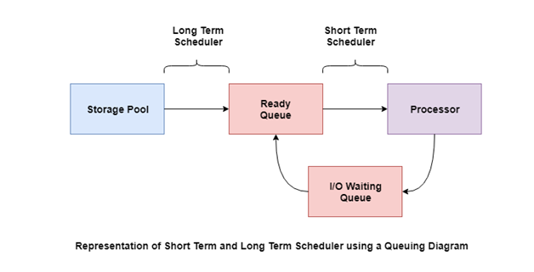
A diagram that demonstrates scheduling using long-term and short-term schedulers is given as follows −

Slide 31
Medium-Term Scheduling
Medium-term scheduling involves swapping out a process from main memory. The process can be swapped in later from the point it stopped executing. This can also be called as suspending and resuming the process and is done by the medium-term scheduler.
This is helpful in reducing the degree of multiprogramming. Swapping is also useful to improve the mix of I/O bound and CPU bound processes in the memory.

Slide 32
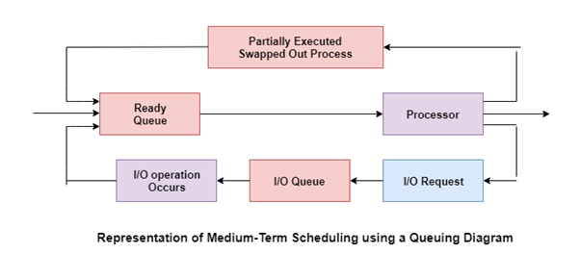
A diagram that demonstrates medium-term scheduling is given as follows −

Slide 33
Multiprocessing and Interactive Systems
A Multiprocessing operating system consists of multiple processors to execute the programs and all the processors are connected to the main peripheral. With the help of multiple processor or CPU, the program can execute simultaneously on the main memory of the system.
In Interactive Operating System there is a direct interaction between the user and the computer. Mostly all the Personal Computers are Interactive Operating System. In this kind of Operating system, the user input some command in the system and the system works according to it.

Slide 34
Concurrent Processes
Concurrent processing is a computing model in which multiple processors execute instructions simultaneously for better performance. The tasks are broken into sub-types, which are then assigned to different processors to perform simultaneously, sequentially instead, as they would have to be performed by one processor. Concurrent processing is sometimes synonymous with parallel processing.

Slide 35
Precedence Graphs
Precedence Graph is a directed acyclic graph which is used to show the execution level of several processes in operating system. It consists of nodes and edges. Nodes represent the processes and the edges represent the flow of execution.
Properties of Precedence Graph: Following are the properties of Precedence Graph:
It is a directed graph.
It is an acyclic graph.
Nodes of graph correspond to individual statements of program code.
Edge between two nodes represents the execution order.
A directed edge from node A to node B shows that statement A executes first and then Statement B executes.

Slide 36
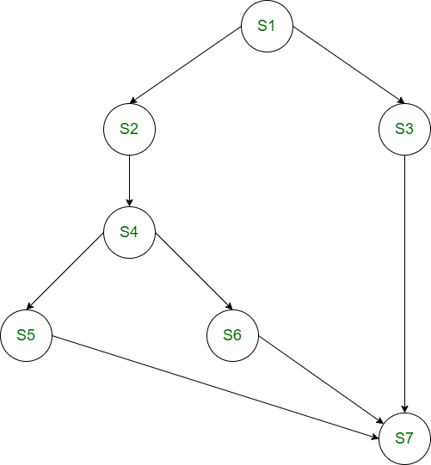
Example: Consider the following precedence relations of a program:
S2 and S3 can be executed after S1 completes.
S4 can be executed after S2 completes.
S5 and S6 can be executed after S4 completes.
S7 can be executed after S5, S6 and S3 complete.

Slide 37
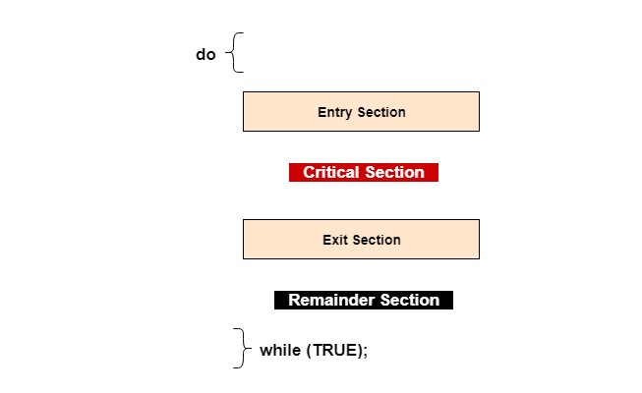
Critical Section Problem
The critical section is a code segment where the shared variables can be accessed. An atomic action is required in a critical section i.e. only one process can execute in its critical section at a time. All the other processes have to wait to execute in their critical sections. A diagram that demonstrates the critical section is as follows −

Slide 38
In the above diagram, the entry section handles the entry into the critical section. It acquires the resources needed for execution by the process. The exit section handles the exit from the critical section. It releases the resources and also informs the other processes that the critical section is free.
Solution to the Critical Section Problem
The critical section problem needs a solution to synchronize the different processes. The solution to the critical section problem must satisfy the following conditions −
Mutual Exclusion- Mutual exclusion implies that only one process can be inside the critical section at any time. If any other processes require the critical section, they must wait until it is free.
Progress- Progress means that if a process is not using the critical section, then it should not stop any other process from accessing it. In other words, any process can enter a critical section if it is free.
Bounded Waiting- Bounded waiting means that each process must have a limited waiting time. It should not wait endlessly to access the critical section.

Slide 39
Semaphores
Semaphore is simply a variable that is non-negative and shared between threads. This variable is used to solve the critical section problem and to achieve process synchronization in multiprocessing environment. It uses two atomic operations, 1)wait, and 2) signal for the process synchronization.
A semaphore either allows or disallows access to the resource, which depends on how it is set up.
Characteristic of Semaphore
It is a mechanism that can be used to provide synchronization of tasks.
It is a low-level synchronization mechanism.
Semaphore will always hold a non-negative integer value.
Semaphore can be implemented using test operations and interrupts, which should be executed using file descriptors.

Slide 40
Types of Semaphores
The two common kinds of semaphores are
Binary semaphores.
Counting semaphores
Binary Semaphores
This is also known as mutex lock. It can have only two values- 0 and 1. Its value is initialized to 1. It is used to implement the solution of critical section problems with multiple processes.
Counting Semaphores
Its value can range over an unrestricted domain. It is used to control access to a resource that has multiple instance.

Slide 41
Wait and Signal Operations in Semaphores
Both of these operations are used to implement process synchronization. The goal of this semaphore operation is to get mutual exclusion.
Wait for Operation
This type of semaphore operation helps you to control the entry of a task into the critical section. However, If the value of wait is positive, then the value of the wait argument X is decremented. In the case of negative or zero value, no operation is executed. It is also called P(S) operation.
Code P(S)
{
while (S<=0);
S--;
}

Slide 42
Signal operation
This type of Semaphore operation is used to control the exit of a task from a critical section. It helps to increase the value of the argument by 1, which is denoted as V(S).
Code V(S)
{
while (S>=0);
S++;
}

Slide 43
Classical Process
We will see number of classical problems of synchronization as examples of a large class of concurrency-control problems. In our solutions to the problems, we use semaphores for synchronization, since that is the traditional way to present such solutions. However, actual implementations of these solutions could use mutex locks in place of binary semaphores.
These problems are used for testing nearly every newly proposed synchronization scheme. The following problems of synchronization are considered as classical problems:
Producer-consumer problem (Bounded Buffer Problem)
Reader-writer problem
Dining philosophers problem
Barber’s shop problem

Slide 44
Producer-Consumer Problem (Bounded-Buffer or Producer-Consumer Problem)
Bounded Buffer problem is also called producer consumer problem. This problem is generalized in terms of the Producer-Consumer problem. Solution to this problem is, creating two counting semaphores “full” and “empty” to keep track of the current number of full and empty buffers respectively. Producers produce a product and consumers consume the product, but both use of one of the containers each time.

Slide 45
Reader-Writer Problem
In this problem there are some processes(called readers) that only read the shared data, and never change it, and there are other processes(called writers) who may change the data in addition to reading.
There are various type of readers-writers problem, most on relative priorities of readers and writers.
The main complexity with this problem occurs from allowing more than one reader to access the data at the same time.

Slide 46
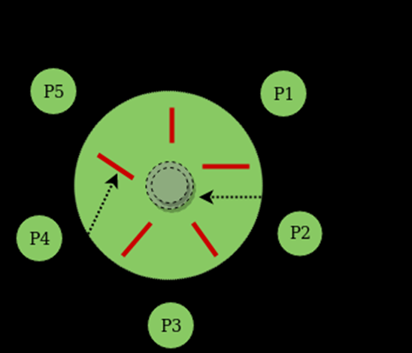
Dining Philosophers Problem
The dining philosopher's problem involves the allocation of limited resources to a group of processes in a deadlock-free and starvation-free manner.
There are five philosophers sitting around a table, in which there are five chopsticks/forks kept beside them and a bowl of chowmin in the center, When a philosopher wants to eat, he uses two chopsticks - one from their left and one from their right. When a philosopher wants to think, he keeps down both chopsticks at their original place.

Slide 47
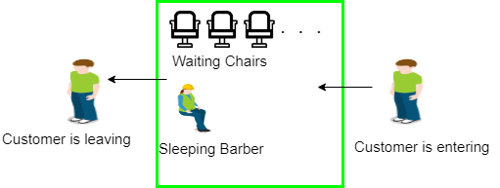
Barber’s Shop Problem
Barber shop with one barber, one barber chair and N chairs to wait in. When no customers the barber goes to sleep in barber chair and must be woken when a customer comes in. When barber is cutting hair new customers take empty seats to wait, or leave if no vacancy.

Slide 48
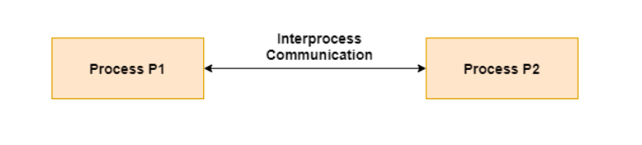
Interprocess Communication
Interprocess communication is the mechanism provided by the operating system that allows processes to communicate with each other. This communication could involve a process letting another process know that some event has occurred or the transferring of data from one process to another.
A diagram that illustrates interprocess communication is as follows −

Slide 49
Approaches for Inter-Process Communication
Here, are few important methods for interprocess communication:
Pipes
Pipe is widely used for communication between two related processes. This is a half-duplex method, so the first process communicates with the second process. However, in order to achieve a full-duplex, another pipe is needed.
Message Passing:
It is a mechanism for a process to communicate and synchronize. Using message passing, the process communicates with each other without resorting to shared variables.
IPC mechanism provides two operations:
Send (message)- message size fixed or variable
Received (message)

Slide 50
Message Queues:
A message queue is a linked list of messages stored within the kernel. It is identified by a message queue identifier. This method offers communication between single or multiple processes with full-duplex capacity.
Direct Communication:
In this type of inter-process communication process, should name each other explicitly. In this method, a link is established between one pair of communicating processes, and between each pair, only one link exists.
Indirect Communication:
Indirect communication establishes like only when processes share a common mailbox each pair of processes sharing several communication links. A link can communicate with many processes. The link may be bi-directional or unidirectional.

Slide 51
Shared Memory:
Shared memory is a memory shared between two or more processes. This type of memory requires to protected from each other by synchronizing access across all the processes.
FIFO:
Communication between two unrelated processes. It is a full-duplex method, which means that the first process can communicate with the second process, and the opposite can also happen.

Slide 52
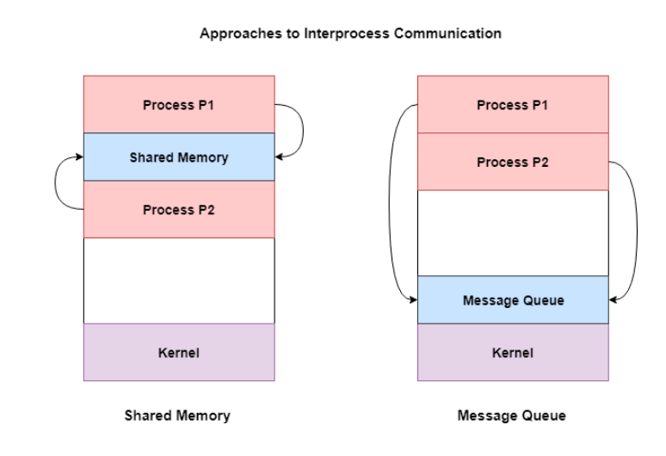
A diagram that demonstrates message queue and shared memory methods of interprocess communication is as follows −

Slide 53
THE END

